Slide 1
Status October 13th
Digital
Range Finder
CSI
Bus
USB
Raspberry Pi
Arduino UNO
Tilt Servo
Raspberry Pi Camera
Webserver
Pan Servo
OpenCV
WiFi Dongle

Slide 2
Raspberry Pi
CSI
Bus
Serial
over USB
Webserver
Serial
Raspberry Pi Camera
Arduino UNO
Range Finder
MySQL
Analog
Digital
OpenCV
Pan Servo
USB
Tilt Servo
WiFi Dongle

Slide 3
Start
Mode?
Autonomously Select Targets for Automatic Scanning
Manually Select Targets for Automatic Scanning
User Selects Target to Measure within FOV
Traverse to Next Point
Yes
Aimed?
No
Execute Measurement Algorithm
Aim Pan-Tilt Towards Target
Execute Measurement Algorithm
No
Change?
Display Information to User
Yes
Email/Text User

Slide 4
Read in Database
Move Pan-Tilt
Read Laser
Compare to
dist in db
Not Equal
Add to Target String
No
Done?
Yes
Return String to User

Slide 5
User Moves Pan-Tilt to Next Point
Manually Select Targets for Automatic Scanning
Measure Point to Obtain Profile
Save Configuration and Profile for Later Comparison
Yes
Next?
No

Slide 6
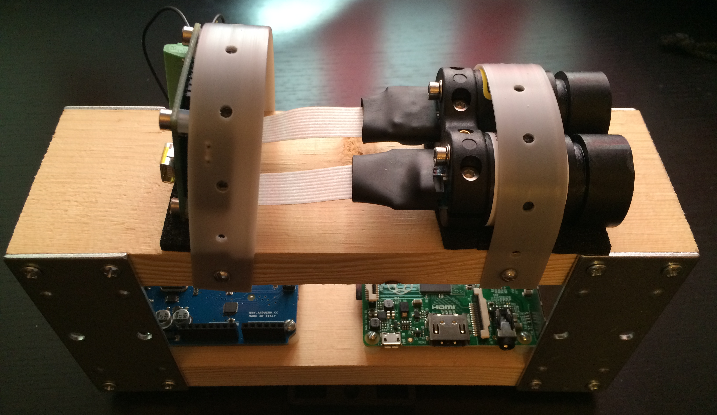
Hanger Strap
Foam Pad
Mount Points
¼ inch Stand Off with Screw
1x3 inch Bracket

Slide 7
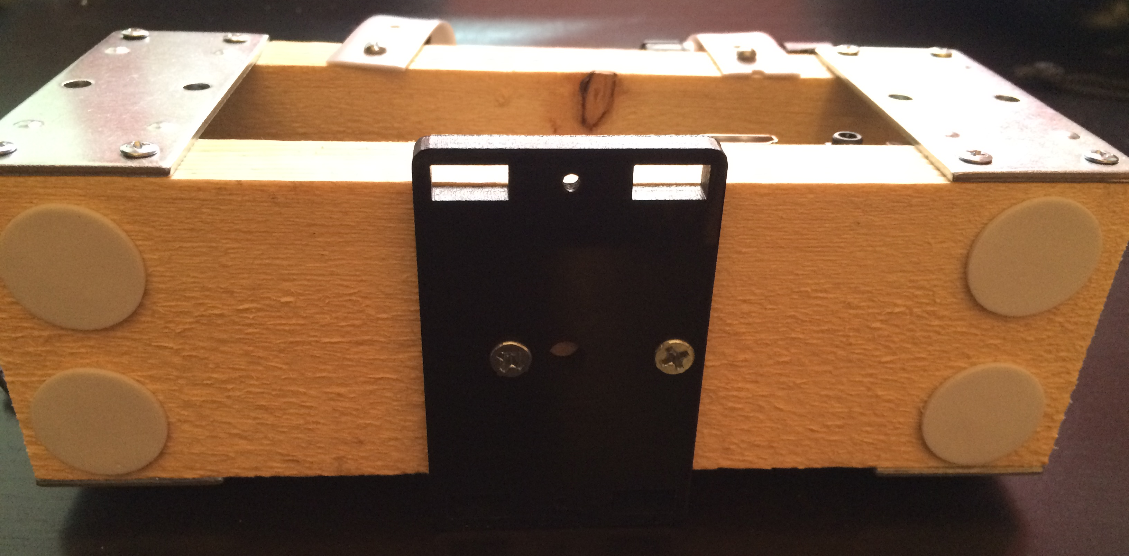
Mounting Plate
Mounting Holes

Slide 8



Slide 9
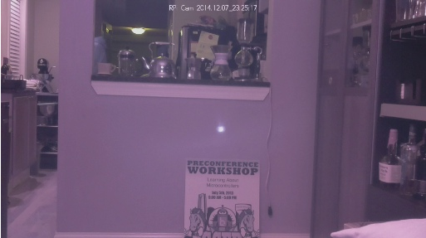
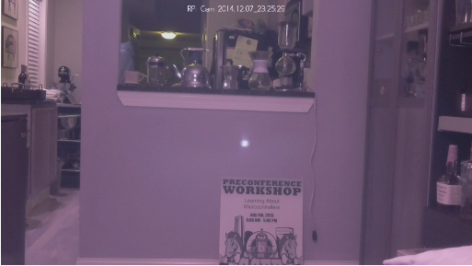

Slide 10
Status October 20th
Bottom of Board
Top of Board
Raspberry Pi
Connector
LRF
Arduino
Servo 1
Servo 2
5 V
GND
Vin
GND
TX
RX
Aout
Vin
GND
TX
RX
Ain
D1
D2
Vin
GND
D
Vin
GND
D
13x2 Pin Connector

Slide 11
Status November 3rd
USB Serial
Digital
Raspberry Pi
Arduino UNO
Pan Servo
5 V 2 A Power Supply
Laptop Power

Slide 12
Raspberry Pi 2x13
LRF 1x5
Arduino 1x7
Servos 1x3
Barrel Jack

Slide 13
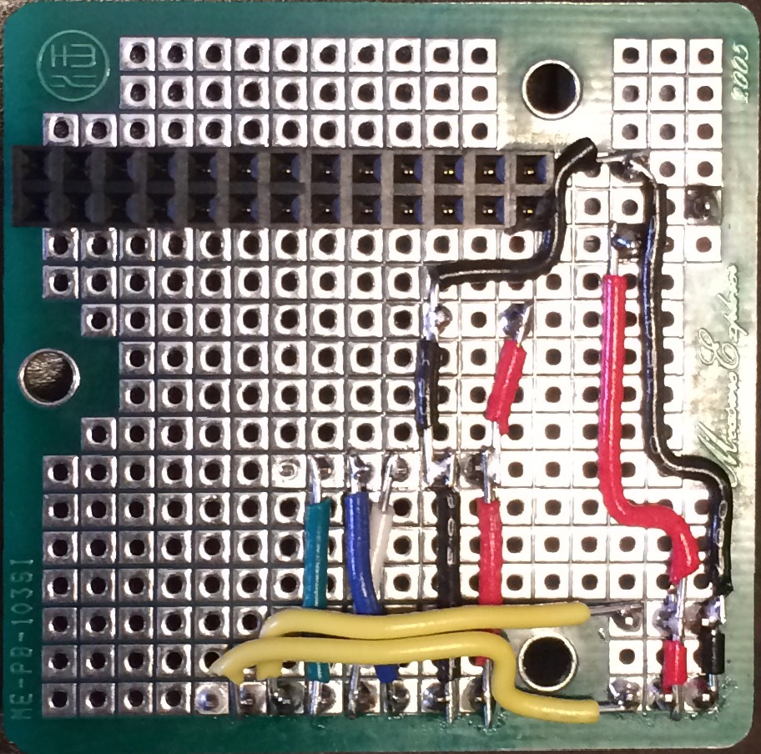
Raspberry Pi Header
Barrel Jack
5 V from Pi
LRF Pins
Servo Pins
Arduino Pins

Slide 14
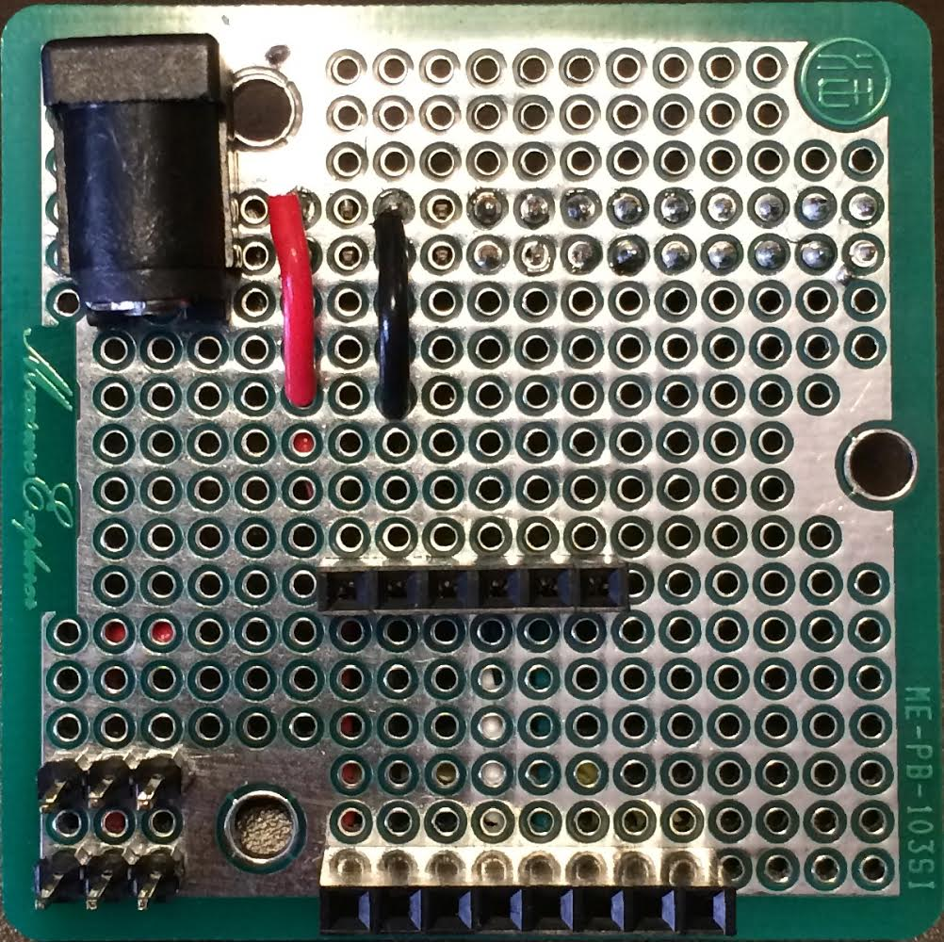
Barrel Jack
LRF Pins
Servo Pins
Arduino Pins

